Slide 1
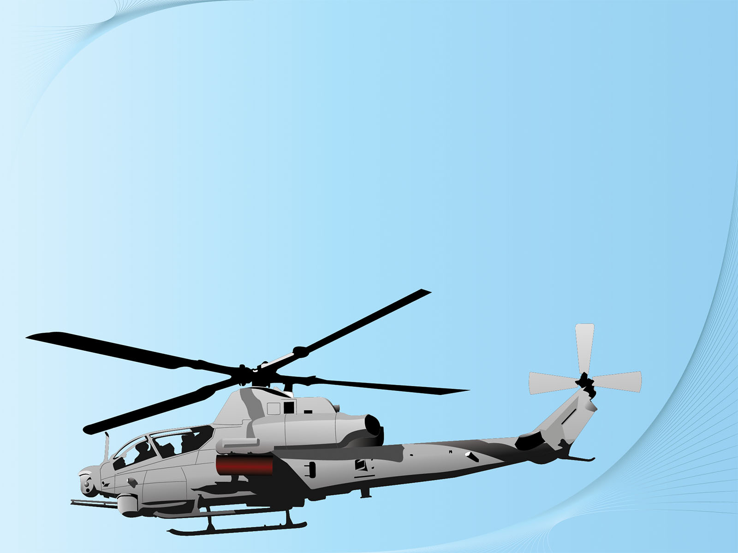

MILITARY INSTITUTE OF SCIENCE & TECHNOLOGY
DEPARTMENT OF
AERONAUTICAL ENGINEERING

Slide 2
DESIGN, ANALYSIS AND FABRICATION OF A FULLY ARTICULATED HELICOPTER’s MAIN ROTOR SYSTEM

Slide 3

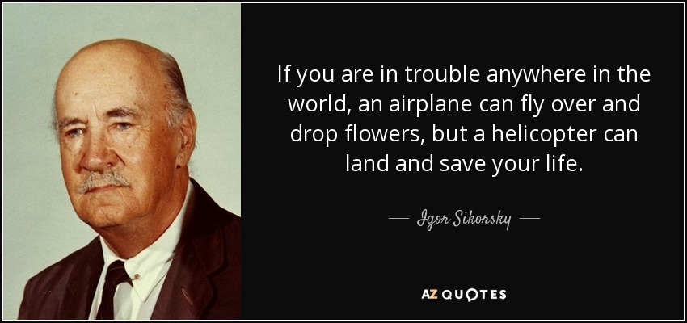

Slide 4

SUPERVISED BY:
Gp. Capt. A L Golani, IAF
Professor (Senior Instructor)
Department of Aeronautical Engineering (AE)
Military Institute of Science and Technology (MIST)

Slide 5
TEAM MEMBER
SAMIN YASER AHMED
ARAFAT AHMED
NAZIB EADIN
SABRINA SAYEDA AMIN
ABU SALEH MD. MUHID
TAIMUM AL-NAFIS
SHAMIM FERDOUS ZADID
201622025
20162239
201622047
201622051
201522043
201522049
201422058

Slide 6
OBJECTIVES
Design and Fabrication
Change pitch and Angle of Attack (AOA)
Demonstrating basic movements(Collective Pitch & Cyclic Pitch) of the rotor blades
Measuring the lift generated for different RPMs and angle of attacks (AOA)
Force Calculation

Slide 7
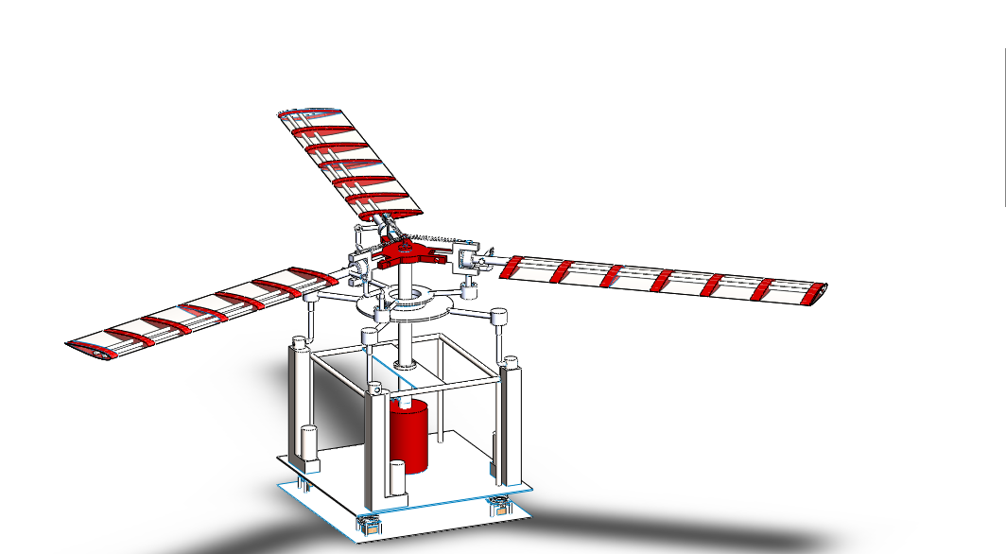
DESIGN, ANALYSIS AND FABRICATION OF A FULLY ARTICULATED HELICOPTER’s MAIN ROTOR SYSTEM

Slide 8
PROCESSES FOLLOWED
Understanding the basic helicopter mechanism.
Designing it in Solidworks.
Fixing the calculation.
Finalizing the measurement.
Validating it on Ansys.
Fabrication.
Controlling Mechanism.
Painting

Slide 9
REFERRED BOOKS FOR THEORY
John M. Seddon and Simon Newman “Basic Helicopter Aerodynamics’’
Alfred Gessow and Garry C. Myers “Aerodynamics of the Helicopter”
Johnson, Wayne “Helicopter theory”

Slide 10
MAIN ROTOR SYSTEM OF HELICOPTER
A helicopter main rotor system is the combination of
Rotor blades
Generates Lift
Control system
Collective Pitch Control
Cyclic Pitch Control
RPM Of Blades

Slide 11
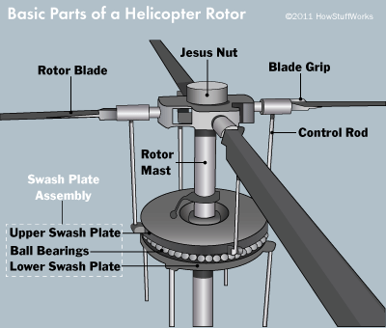
BASIC PARTS OF MAIN ROTOR SYSTEM

Slide 12
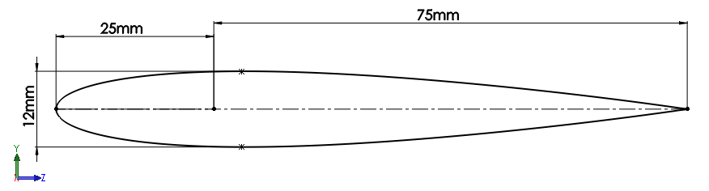
Design of Blade
Selected Airfoil: NACA 0012
FEATURES :
Symmetric Airfoil (Ease in Manufacture)
Optimum Thickness
Low pitching moment co-efficient

Slide 13
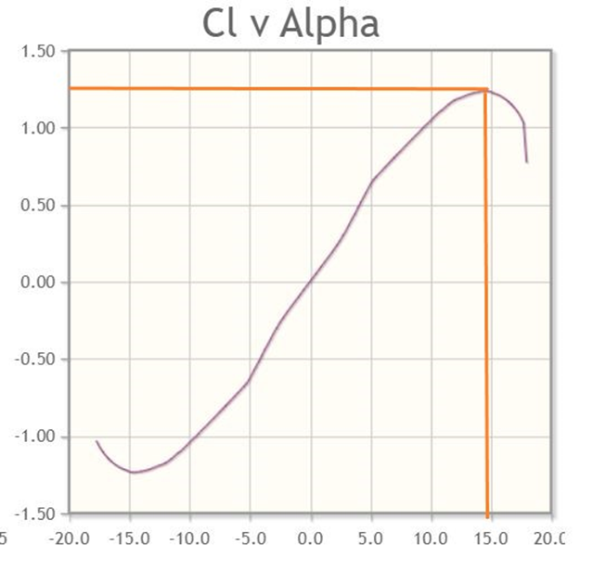
Selected Airfoil: NACA 0012
FEATURES :
Stall Angle: 15° (approx.)
Smooth Curve Of C_{L} Vs Alpha
Cl
Alpha

Slide 14
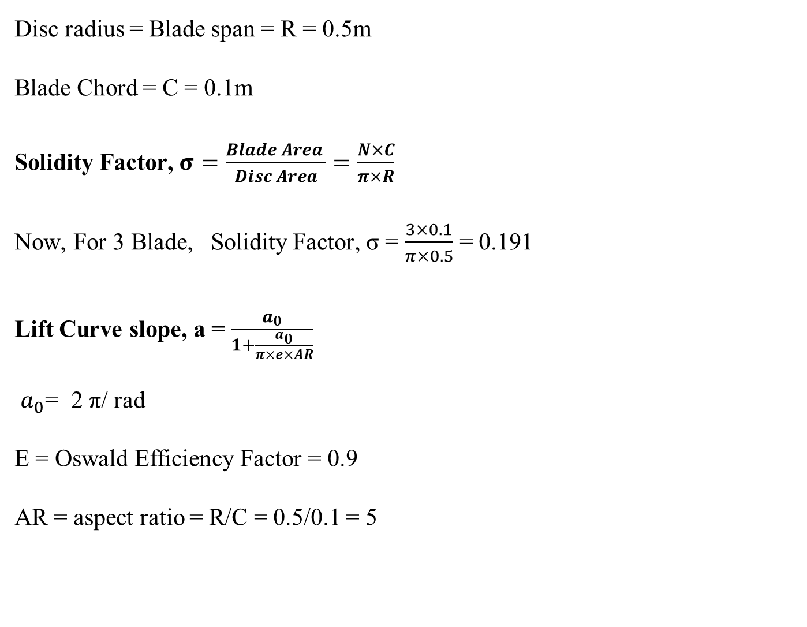
Calculation

Slide 15
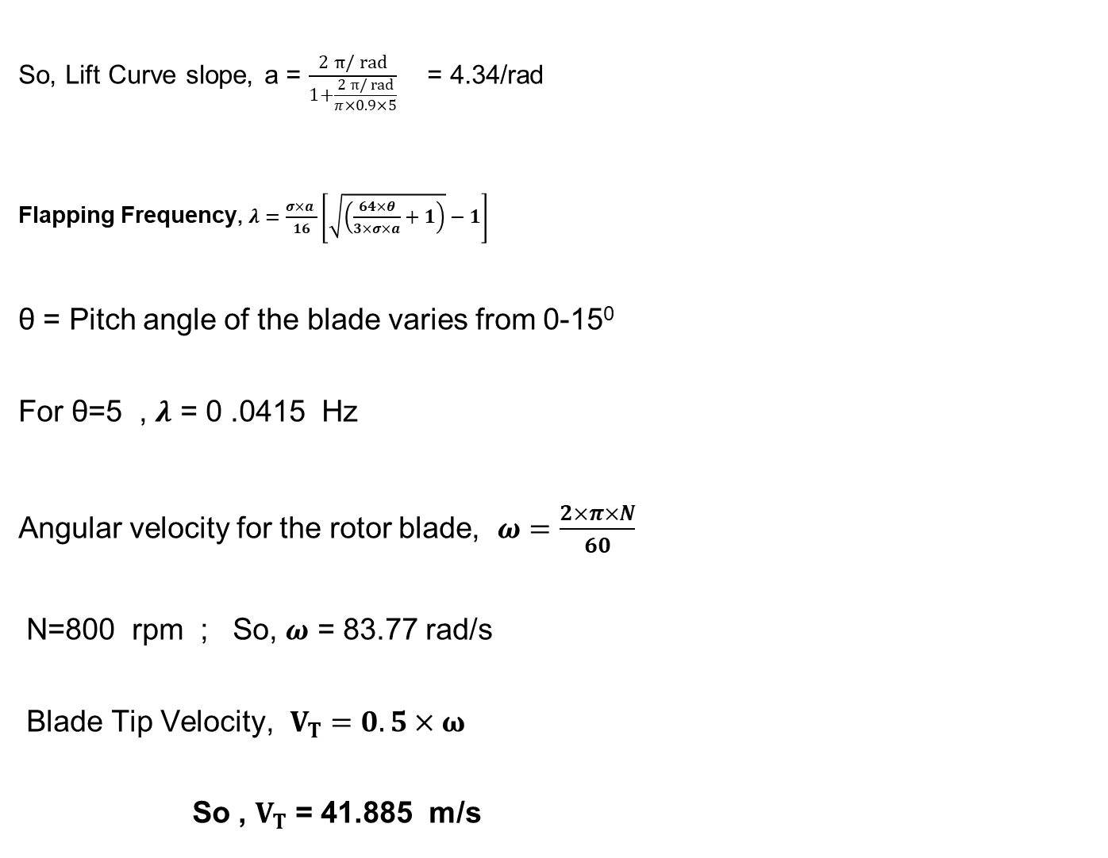

Slide 16
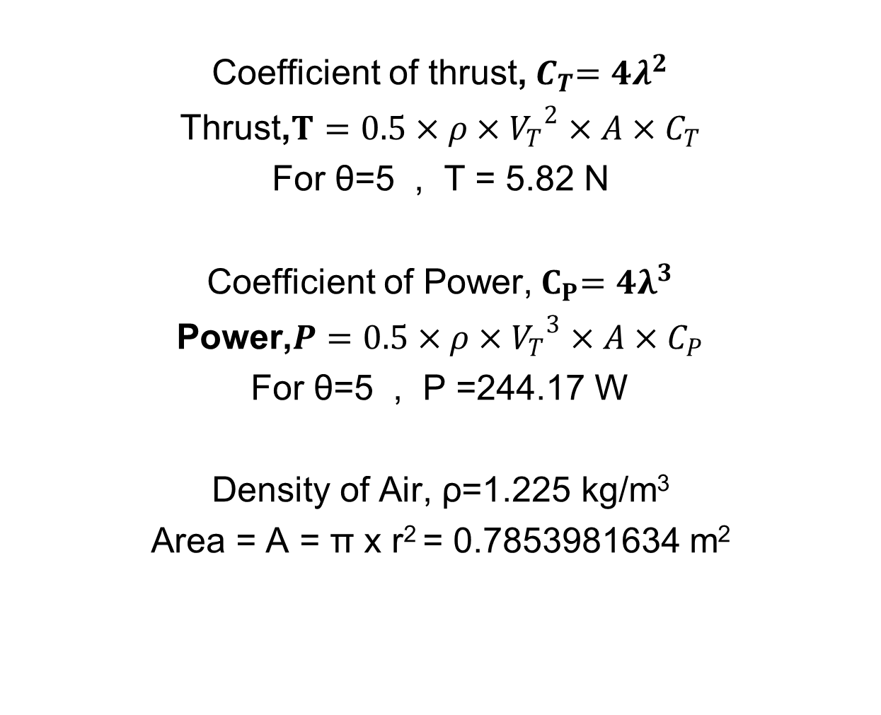

Slide 17
Power = 244.17 W
Power in HP = 0.3
Used Motor RPM =800
Power = 0.4 HP

Slide 18
MAIN ROTOR CONTROLS
Cyclic blade control:
used to change a helicopter's roll and pitch
By tilting swashplate AOA can be varied
Negative AOA at the advancing blades & positive AOA at the retreating blades
Collective blade control:
To control the collective pitch of the main rotor blades
By lifting swashplate without tilting it
All blades need to have same AOA

Slide 19
FULLY ARTICULATED JOINTS
FLAPPING:
Flapping is the vertical movement of a blade up or down to increase or decrease lift in order to compensate for dissymmetry of lift.
FEATHERING:
Feathering changes blade angle (pitch) and influences the blade's angle of attack.
A blade feathers along its longitudinal axis, and a bearing is usually used to support this.
LEAD LAG:
Leading and lagging is the horizontal movement of the rotor blades forwards and backwards along a vertical hinge.
It reduces the stress on the rotor system due to blade flapping

Slide 20
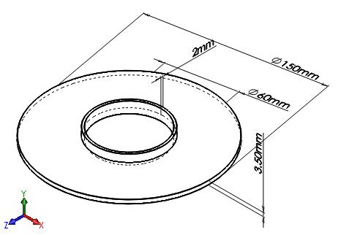
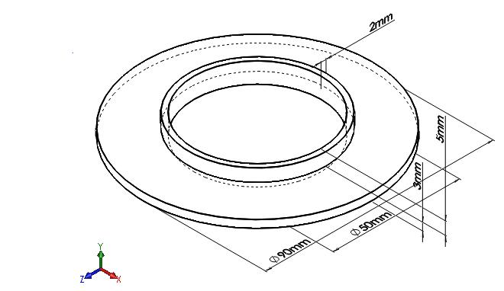
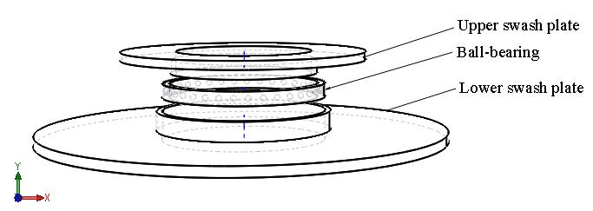
CAD DESIGN
Swash Plates:
Fig: 3D view of Upper and Lower Swash Plate.
Fig: Swash Plate Assembly.

Slide 21
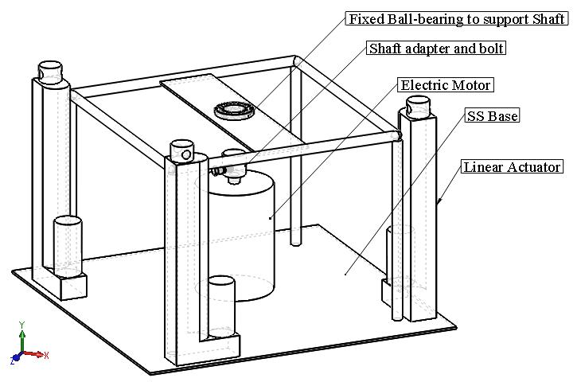
CAD DESIGN
Final Base Assembly:
Fig: 3D view of Base Assembly.

Slide 22
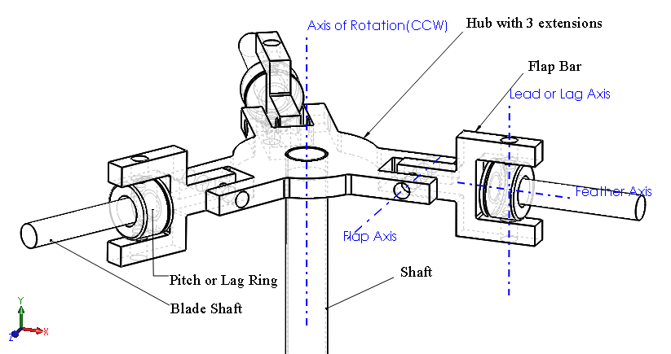
CAD DESIGN
Articulated Joints Assembly:
Fig: Articulated Joints.

Slide 23
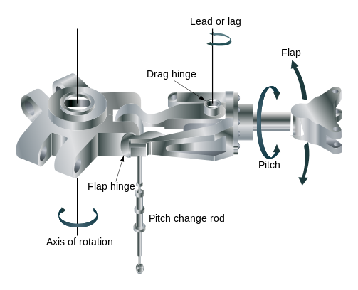
CAD DESIGN
Conventional Articulated Joints Assembly:
Fig: Articulated Joints.

Slide 24
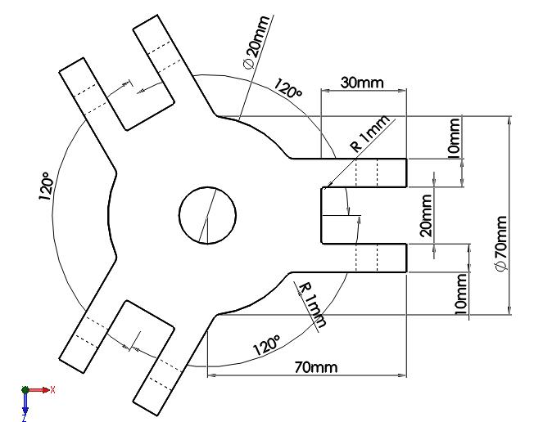
CAD DESIGN
Hub:
Fig: 3D view of Hub

Slide 25
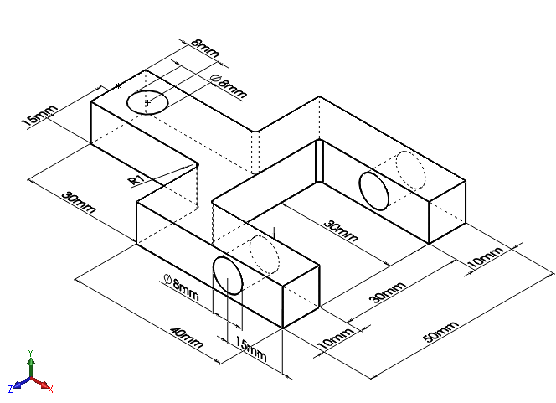
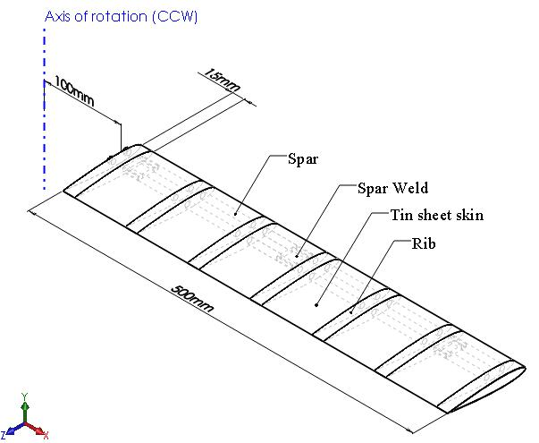
CAD DESIGN
Articular Joint:
Blade:
Fig: 3D View of Articular Joint.
Fig: 3D View of Blade.

Slide 26
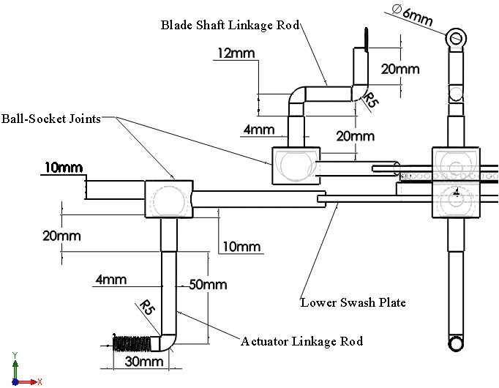
CAD DESIGN
Linkage-Rod Assembly:
Fig: 3D view of Linkage-Rod Assembly.

Slide 27
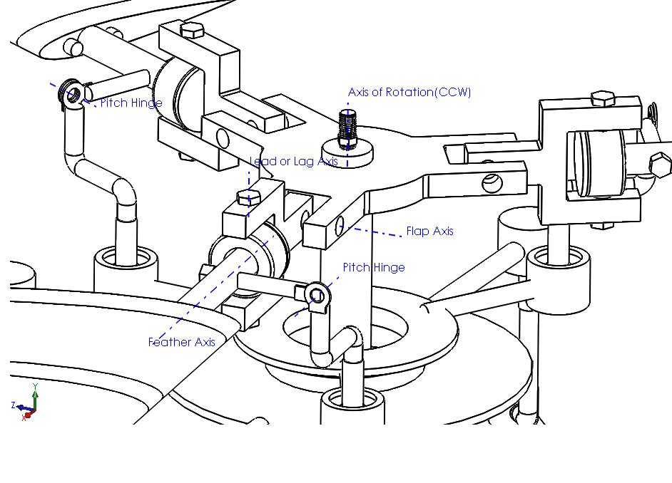
CAD DESIGN
Final Assembly of the System:
Fig: 3D view of Final Assembly of the system.

Slide 28
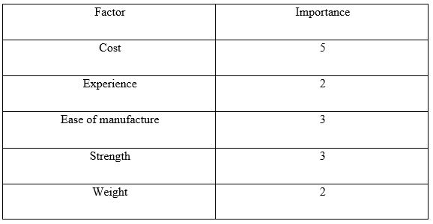
FABRICATION OF ROTOR MECHANISM
Selection Process:
FIGURE OF MERIT

Slide 29
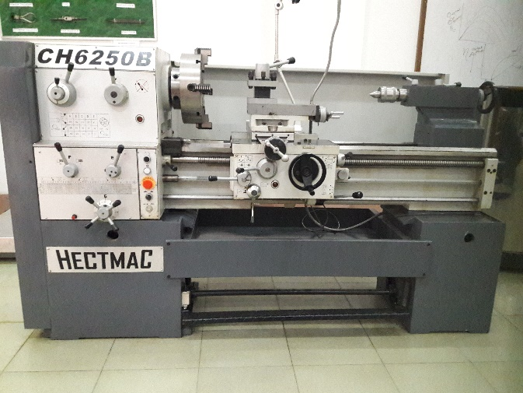
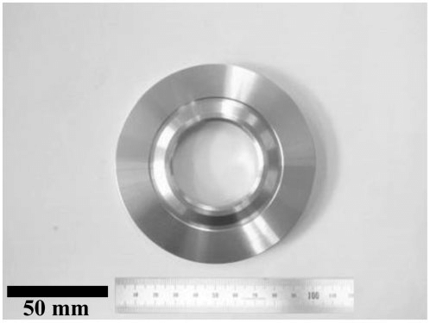
FABRICATION OF ROTOR MECHANISM
Manufacturing of Parts:
Upper swash plate:
Material Used: Mild Steel
Manufacturing Technique: Turning, Facing, Sanding.
Machine Used: Lathe Machine.
Dimension: 124.69 mm outer diameter and 88 mm inner diameter and with a height of 15 mm.
Fig: Fabrication Process of Upper Swash Plate.

Slide 30
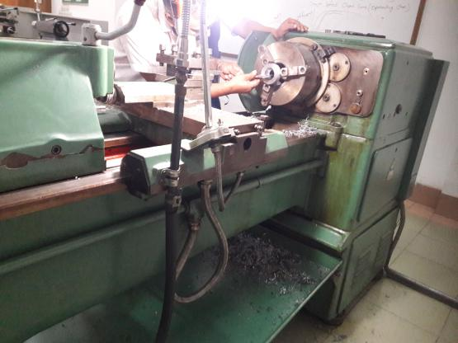
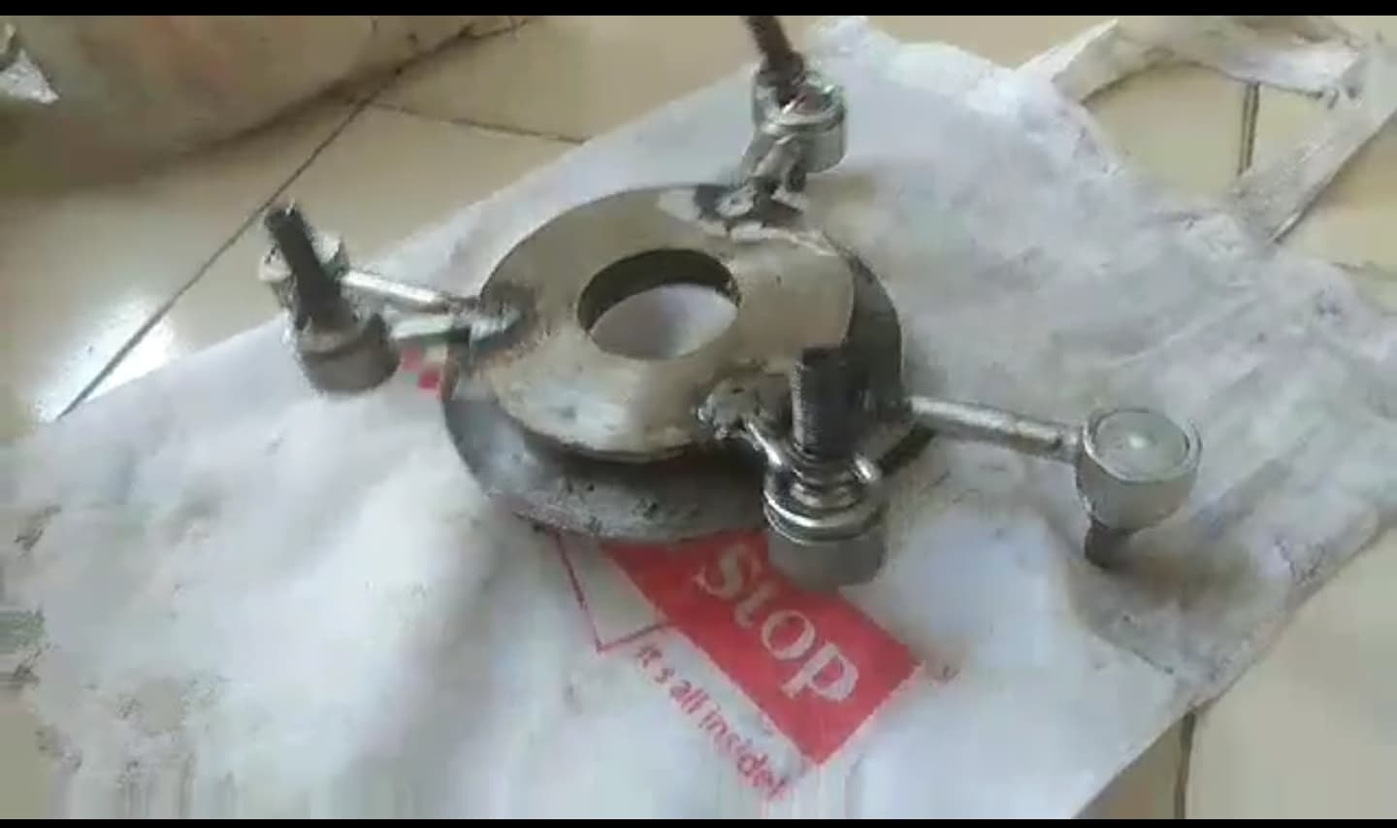
FABRICATION OF ROTOR MECHANISM
Manufacturing of Parts:
Lower swash plate:
Material Used: Mild Steel
Manufacturing Technique: Turning, Facing, Sanding.
Machine Used: Lathe Machine.
Dimension: 150 mm outer diameter and 78 mm inner diameter and with a height of 15mm.
Fig: Fabrication Process of Lower Swash Plate.

Slide 31
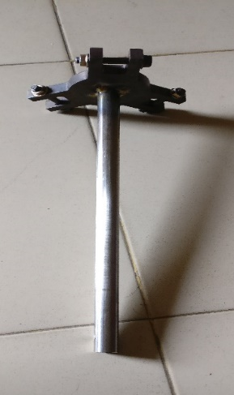
FABRICATION OF ROTOR MECHANISM
Manufacturing of Parts:
Mast:
Material Used: Mild Steel
Manufacturing Technique: Cutting.
Machine Used: Cutting Machine.
Dimension: Hollow shaft with diameter of 18 mm and length 330 mm.
Fig: Fabrication Process of Mast.

Slide 32
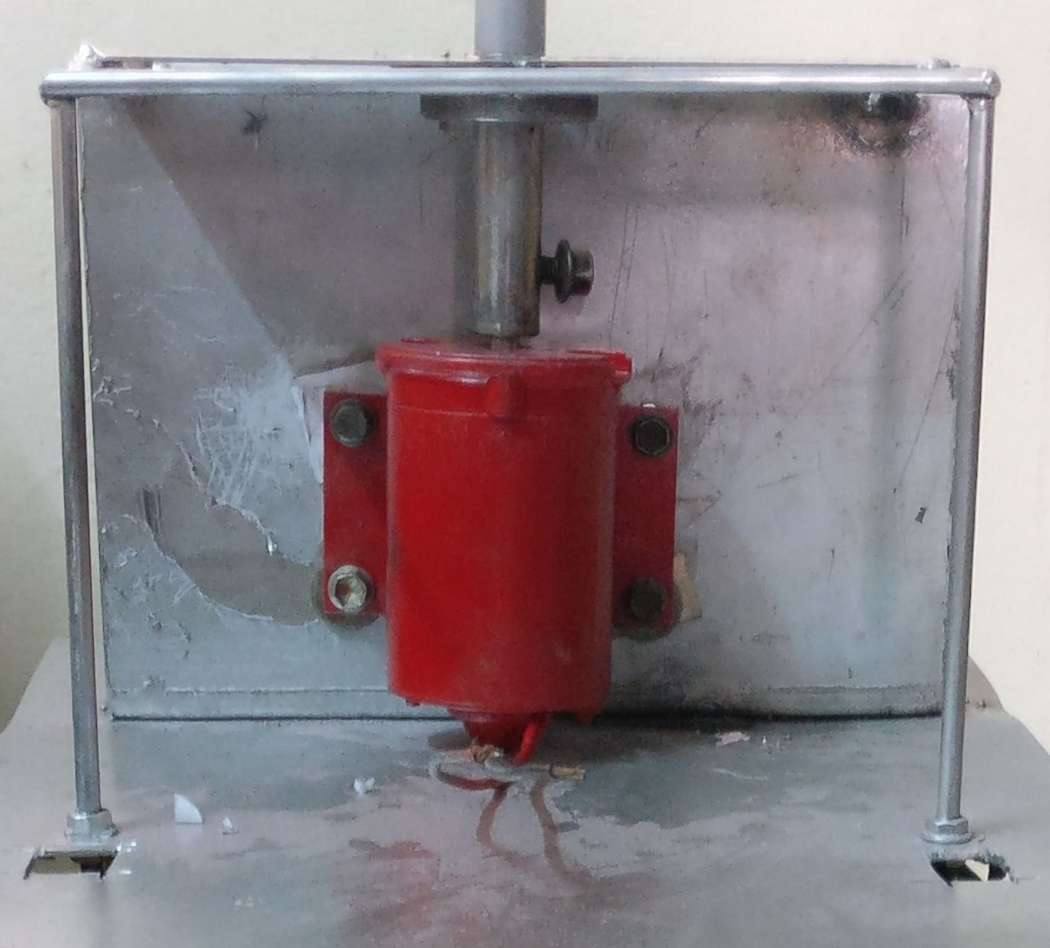
FABRICATION OF ROTOR MECHANISM
Manufacturing of Parts:
Motor Base:
Material Used: Mild Steel
Manufacturing Technique: Welding. Cutting.
Machine Used: Arc Welding Machine. Cutting machine.
Dimension: 250 mm of Length, 180 mm of Width and Thickness 3 mm.
Fig: Fabrication Process of Motor Base.

Slide 33
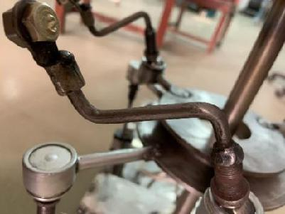
FABRICATION OF ROTOR MECHANISM
Manufacturing of Parts:
Connecting Rod:
Material Used: Mild Steel
Manufacturing Technique: Cutting.
Machine Used: Cutting machine.
Dimension: 180 mm of Length and diameter of 10 mm.
Fig: Fabrication Process of Connecting Rod.

Slide 34
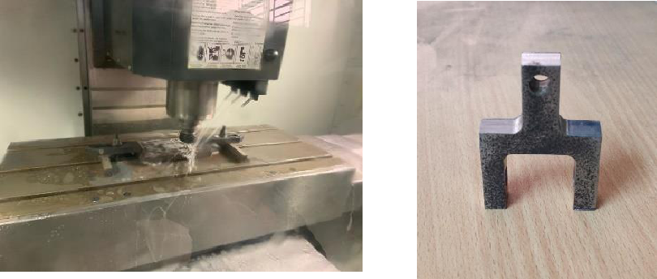
FABRICATION OF ROTOR MECHANISM
Manufacturing of Parts:
Articular Joint:
Material Used: Mild Steel
Manufacturing Technique: Cutting, Drilling and CAD/CAM interface.
Machine Used: Cutting machine, Drilling Machine and CNC machine.
Fig: Fabrication Process of Articular Joint.

Slide 35
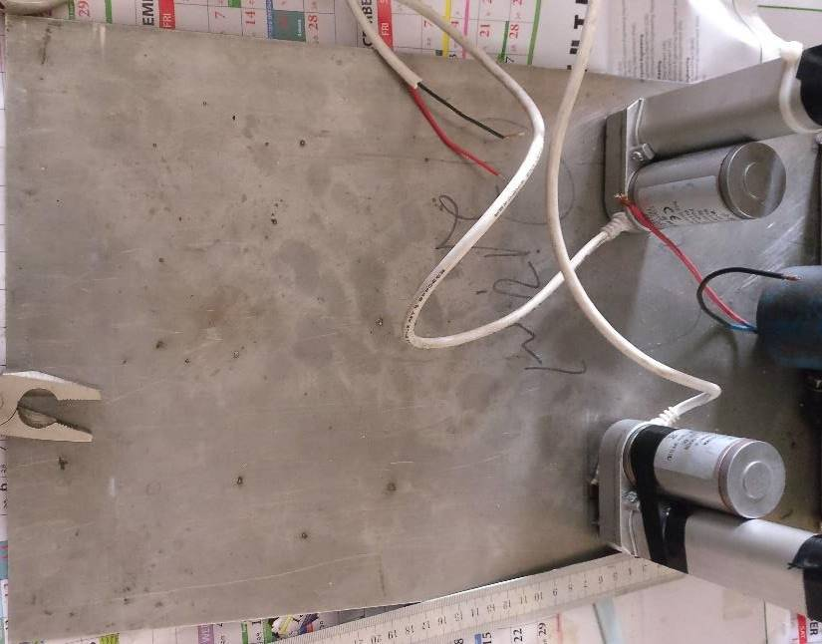
FABRICATION OF ROTOR MECHANISM
Manufacturing of Parts:
Base:
Material Used: Mild Steel
Manufacturing Technique: Cutting, Fitting, Riveting and Welding.
Machine Used: Cutting machine, Arc Welding.
Dimension: 600 mm of Length, Width of 300 mm and thickness of 3 mm.
Fig: Fabrication Process of Base.

Slide 36
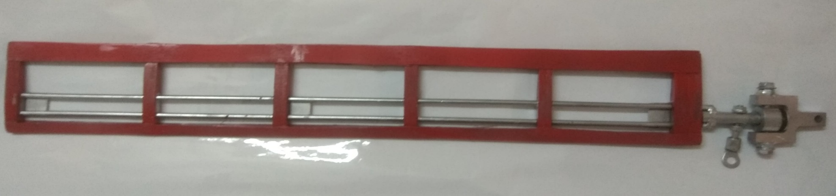
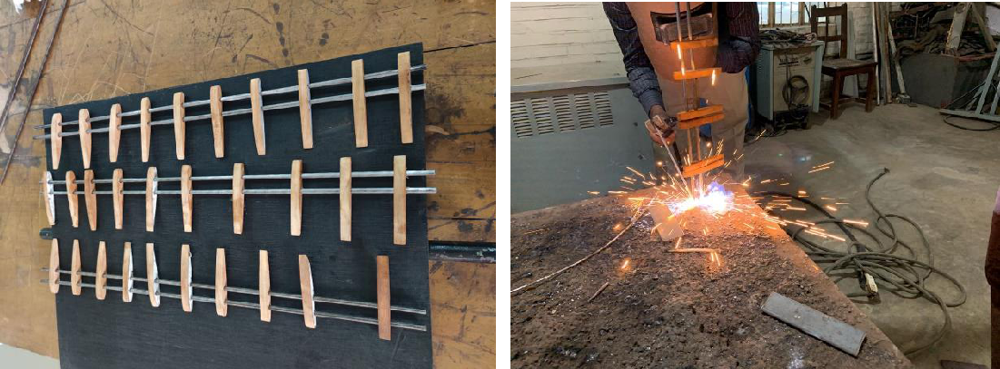
FABRICATION OF ROTOR MECHANISM
Manufacturing of Parts:
Rotor Blade:
Material Used: Mild Steel, Wood.
Manufacturing Technique: Cutting, Welding and Drilling.
Machine Used: Cutting machine, Arc Welding and Drilling Machine.
Fig: Fabrication Process of Rotor Blade.

Slide 37
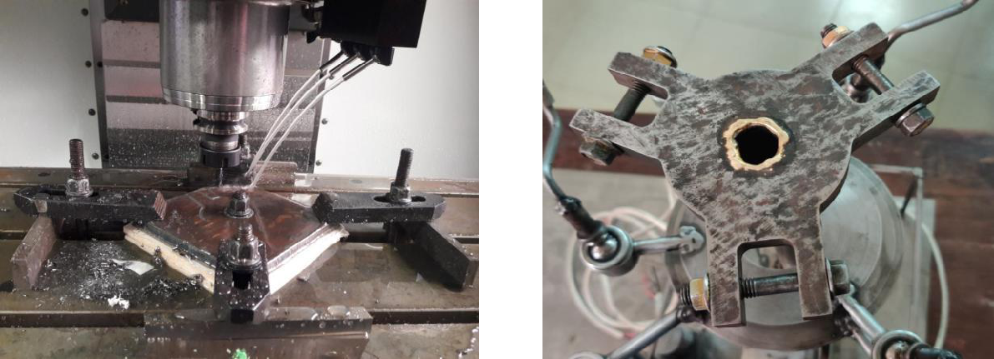
FABRICATION OF ROTOR MECHANISM
Manufacturing of Parts:
Rotor Hub:
Material Used: Mild Steel
Manufacturing Technique: CAD/CAM interfacing, Drilling.
Machine Used: CNC Machine and Drilling Machine.
Dimension: 70 mm of diameter , 3 pair of 35 mm tooth Length and 17 mm of height.
Fig: Fabrication Process of Rotor Hub.

Slide 38
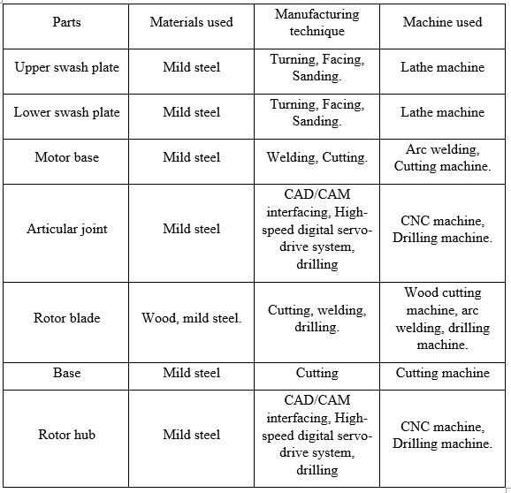
FABRICATION OF ROTOR MECHANISM
Manufacturing Process:

Slide 39

FABRICATION OF ROTOR MECHANISM
Final Assembly:
Fig: Fabrication Process of Rotor Hub.

Slide 40
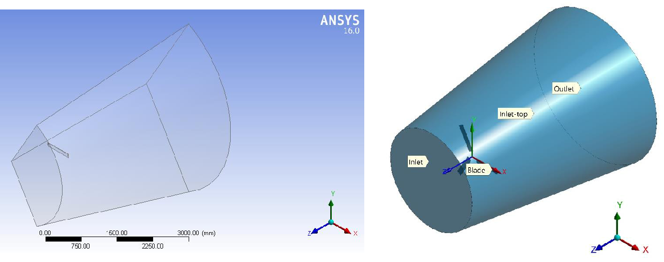
CFD VALIDATION
Guidelines: CFD validation dictates process how model went from a CAD-model to a discretized volume mesh generated in Ansys. The results are gathered from the simulations and indicate significant results from the CAD design, meshing and simulations.
CAD Modeling:
Domain in PBC Method
Domain in Cylindrical Method.

Slide 41
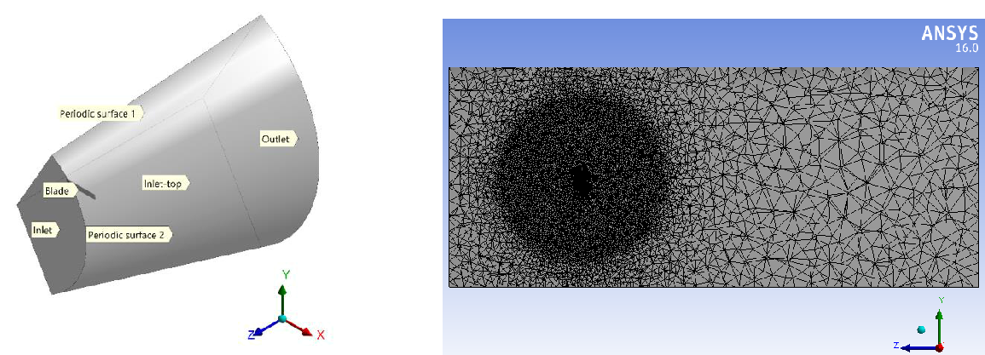
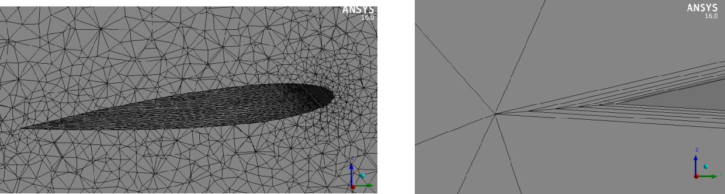
CFD VALIDATION
Meshing:
Cross-Section of Blade.
Cross-Section of Domain in PBC Method.

Slide 42
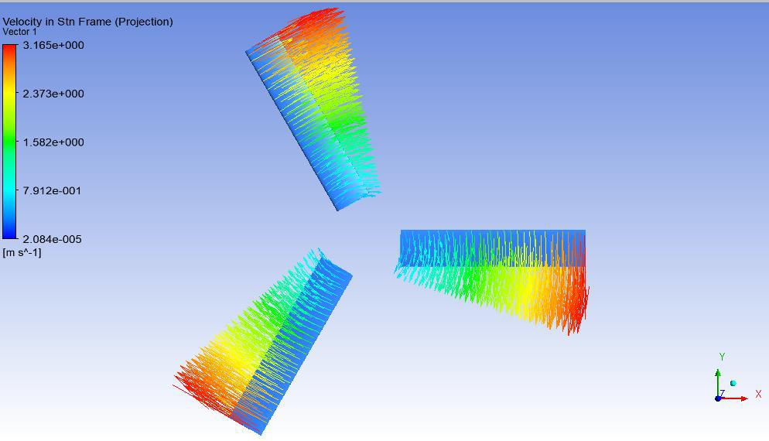
CFD VALIDATION
Flight Simulations in Hovering Mode:
Velocity Vector on Blade at 5 deg Pitch and 50 RPM

Slide 43
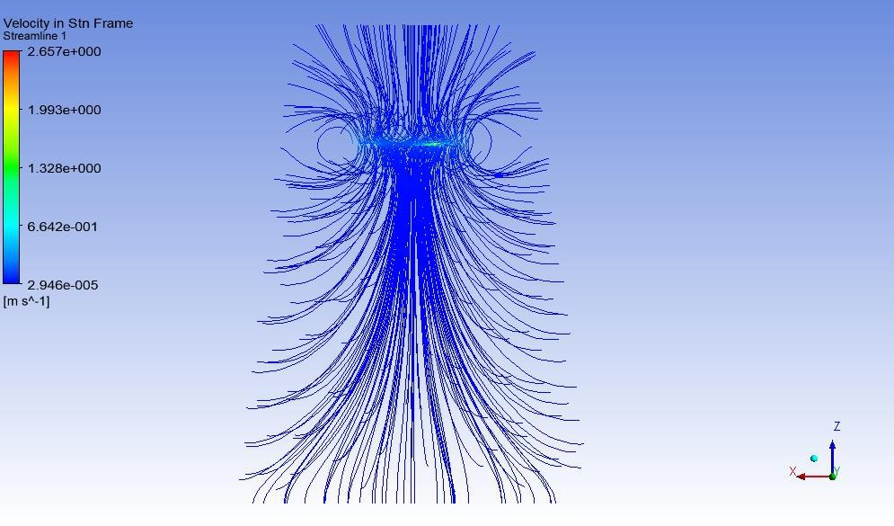
CFD VALIDATION
Flight Simulations in Hovering Mode:
Velocity Streamline in Domain at 5 deg Pitch and 50 RPM

Slide 44
CONCLUDING REMARKS
Limitations:
Limited Time
Shortage of Raw Materials
Unavailability of High-Tech Machinery
Limited Funding
Recommendations:
Use of Composite materials
Use of Balsa wood in manufacturing wing
Use of better equipment
Designing of tail rotor system to develop complete
helicopter

Slide 45

Demonstration of Our Capstone Project

